Slide 1
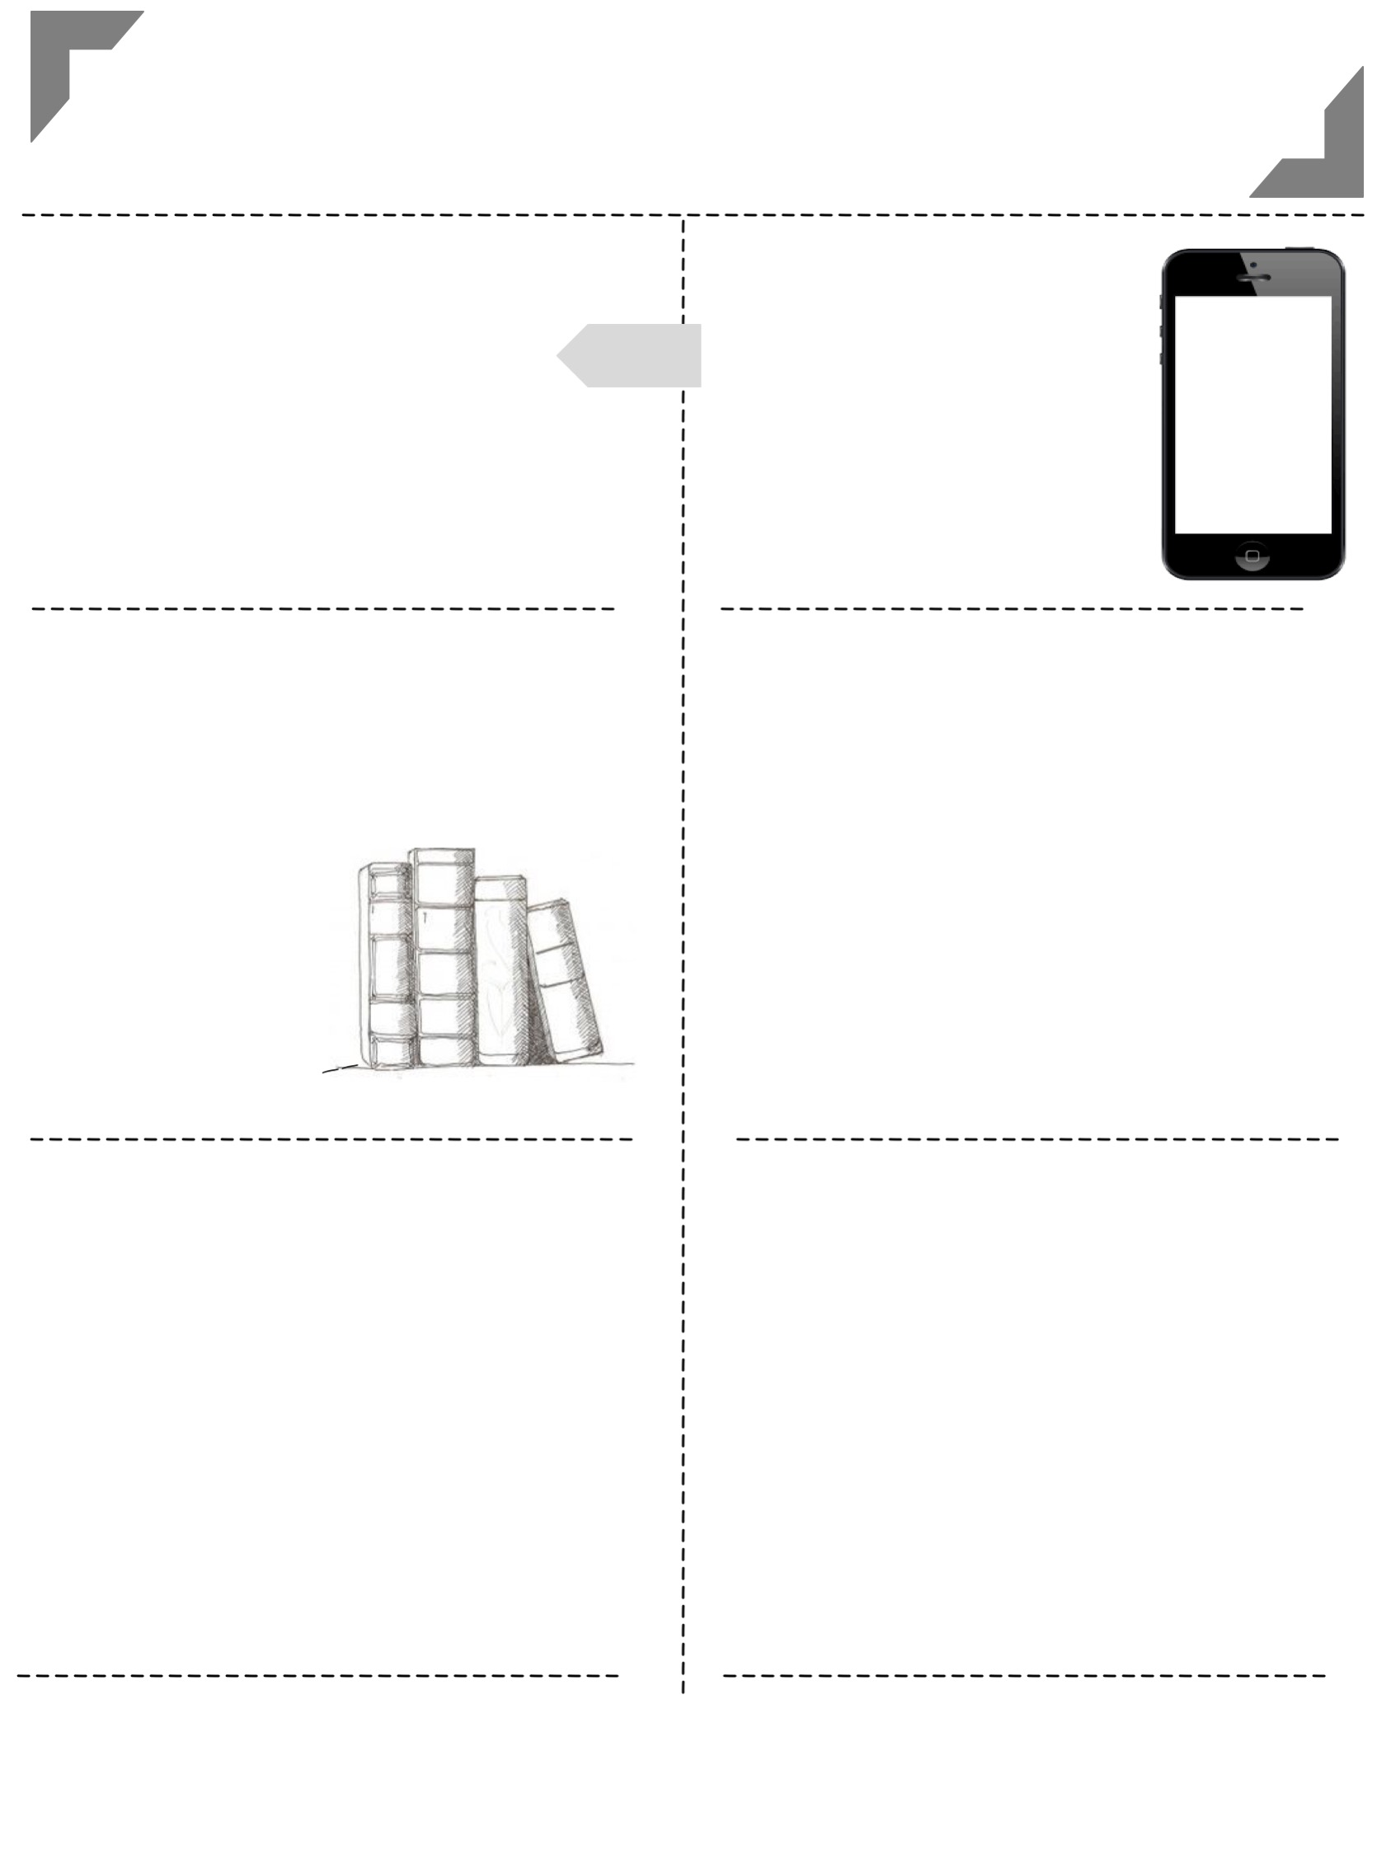
Eighth Grade English
Ms. Rutha
2017 -----
----- 2018
-----------------------------------------------------------------------
-----------------------------------------------------------------------
communication
with the teacher
1 stacie.rutha@uticak12.org
2 Remind1 app chat
3 (586) 797-3370
4 Website: msrutha.weebly..com
eighth
grade
Text Message Alerts
Text @msrutha
to 81010
---------------------------------
---------------------------------
---------------------------------
---------------------------------
class materials
Binder Tabs
1
2
3
Bellwork
1 composition notebook
______
Pencils & highlighters
______
colored pencils,
scissors, glue
________
Notes and Study Guides
3-inch binder with 3tabs
__
Returned Work
grades
Materials and essays
UCS Grading Scale
100 – 94% - A 82-80% - B- 69-67% - D+
93-90% - A- 79-77% - C+ 66-63% - D
89-87% - B+ 76-73% - C 62-60% - D-
86-83% - B 72-70% - C- 59 – 0% - F
The Outsiders, The Devil’s Arithmetic, Touching Spirit Bear, various poetry, short stories, nonfiction, and linking texts.
Essays will include: argumentative, explanatory, and narrative essays along with writing from knowledge and experience.
Grades are points-based, not weighted.
---------------------------------
---------------------------------
Scholastic Online Code: LMXGY

Slide 2
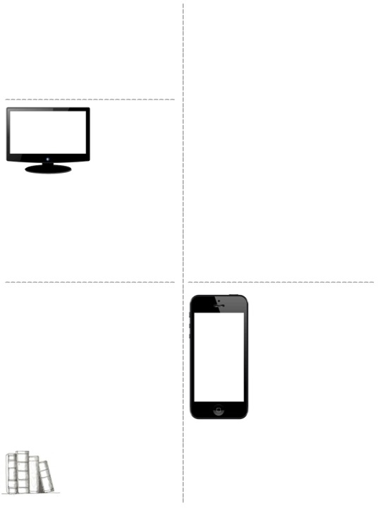
food and drink policy
policy for absences & grades
In general, food and drinks are allowed in my class. This is contingent on it not becoming a distraction in class, and as long as students can handle the responsibility. This policy is subject to change at my discretion, and at any time.
Please check grades regularly and feel free to ask me any questions that you might have about a particular grade. This should be done before or after school or via email, not in the middle of instructional time.
If you are absent, you are responsible for completing your make-up work (one day for make-up for each day absent).
All make-up work and an explanation of work will be placed in your class’s absent binder. It is your responsibility ask a classmate for help on making up any interactive notebook assignments and to obtain notes missed.
Projects, tests, quizzes, and essays that have been assigned with advance notification are due on the assigned due date, regardless of absences prior to that due date.
.
Homework Non-negotiables
All sentences must be complete.
Restate all questions in answers.
Formal essays must be typed, using 12 point font and 1-inch margins.
Paragraphs must include at least 5-7 sentences.
homework
electronic devices
The amount of homework I assign varies. Homework is due the following day, unless otherwise specified. Any homework turned in after I have collected it will be considered late and marked down accordingly. Late homework will be marked down 20% for each day late.
Students may complete a late-work request form in advance once per quarter. If approved, the student will receive full credit for the assignment.
Electronic devices should be kept in students’ lockers. Devices should not be in class at any time.
This is a school-wide policy .
---------------------------------------------
Anyone caught cheating on an assignment will automatically receive a zero. This includes copying homework or class work, copying and pasting from the internet, or using other people’s words as your own.
This form is available on my website.
Plagiarism
and cheating

Slide 3
Expectations
Be respectful. Treat everyone with proper consideration, regardless of whether he/she is in the classroom at the time. Use respectful language, in writing as well as in discussions. Show respect for your environment by keeping the classrooms clean and neat.
Be responsible. Arrive at class on time and with all necessary materials. Complete assignments on time, ask questions when necessary, and stay aware of deadlines. Be prepared for the start of class each day. Do what is right, regardless of what everyone else in class is doing.
Be appropriate. Conduct yourself as a mature, well-mannered young adult. Think before speaking, and make sure all contributions to the class dialogue should be meaningful and pertinent. Take care of personal business when the time is appropriate. Use your privileges wisely.
Be involved. Participate to the fullest extent that you can. Stay awake. Take part in discussions. Ask questions. Answer questions. Stay on task. Take notes. Keep your head up. Do your homework. Use class time efficiently. Listen. Watch. Participate.
Be honest. Do your own work. Do not cheat, and do not plagiarize. Do not attempt to sneak around the rules. Avoid inventing excuses to cover up for your mistakes. Accept consequences for your mistakes, and learn from them.

